Slide 1

Validate Configured Subscription YANG-Push Publisher Implementations IETF 123 Hackathon, July 19-20th 2025
NMOP & NETCONF WG

Slide 2

Hackathon Plan, Software and Website
Test Plan
Subscription automation
Discover YANG-Push systems and notifications capabilities and configure periodical and on-change subscriptions with netconf.
Notification integration
Validate subscription state change and push-update and push-change-update notifications against schema with yanglint
Validate draft-ietf-nmop-message-broker-telemetry-message for draft-ietf-nmop-yang-message-broker-integration integration
Development Plan
MVP 1 – Basic Requirements (9)
MVP 2 – Scale and Secure (3)
MVP 3 – Optimizations (2)
Software
YANG-Push Publisher - Cisco IOS XR
YANG-Push Publisher - 6WIND VSR
YANG-Push Publisher - Huawei NE (Router) and MA (OLT)
YANG-Push Receiver – Netgauze
udp-notif dissector - Wireshark
NMOP & NETCONF WG
https://www.network-analytics.org/yp/how-to-deploy.html

Slide 3
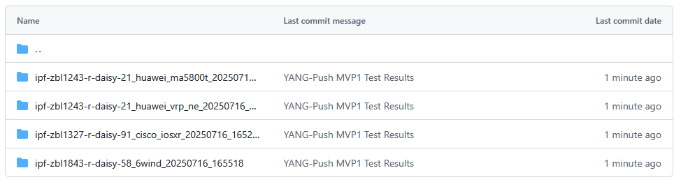
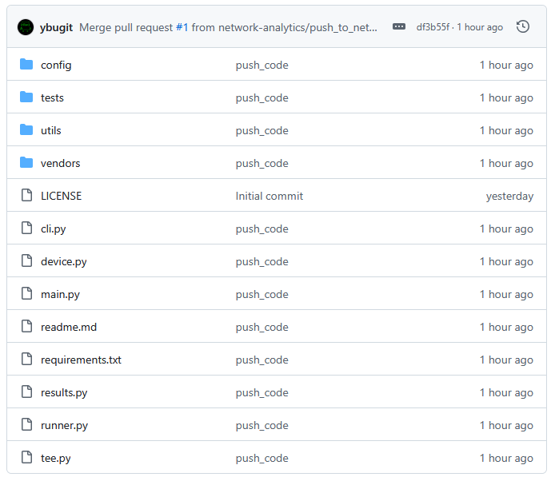
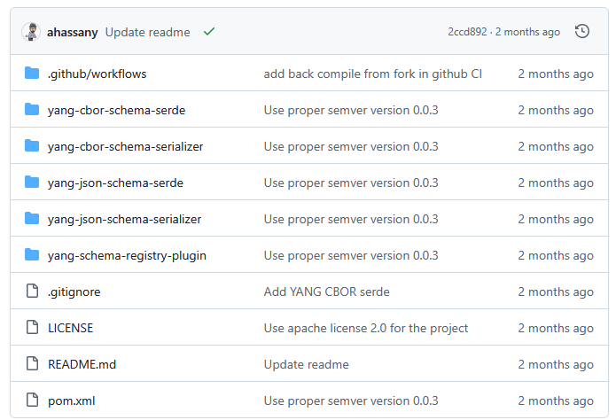
Hackathon – Repositories
Test Result Repository
https://github.com/network-analytics/ietf-network-analytics-document-status/tree/main/123/Hackathon
Packet capture on the wire
Netconf RPCs and YANG-Push JSON and CBOR encoded messages
Test Tool Repository
https://github.com/network-analytics/yp_test
YANG-Push Test Automation Tool
Vendor deviations configuration
Apache Kafka Integration
https://github.com/network-analytics/yang-kafka-integration
YANG Serializer
YANG Schema Registry Plugin
NMOP & NETCONF WG

Slide 4
An Architecture for YANG-Push to Message Broker Integration draft-ietf-nmop-yang-message-broker-integration draft-ietf-nmop-message-broker-telemetry-message
+------------------------------------------------------------+
| Data Storage |
+------------------------------------------------------------+
^
| (12) Ingest Data
| According to Schema
+------------------------------------------------------------+
| Data Consumer |
+------------------------------------------------------------+
| ^ ^
(10) Get | | | (9) Validate
Schema | | | Serialized Message
| | | Schema on Consumer
| | +--------------------+
| | | Message |
| | | Broker |
| | +--------------------+
| | ^
| | | (8) Serialize
| | (11) Issue | YANG-Push Message
| | Schema | annotated Schema
v | (6) Post | ID on Producer
+--------------------+ Schema +--------------------+
| YANG | <--------------- | Data Collection |
| Schema Registry | ---------------> | YANG-Push Receiver |
+--------------------+ (7) Issue +--------------------+
Schema ID | ^ (3) Receive
| | YANG-Push
(4) Discover | | Subscription
Schema | | Start Message
Dependencies | | ^
and Obtain | | | (5) Publish
Schemas | | | YANG-Push
| | | Message
| | | with
(1) Discover | | | Subscriber
Notification v | | ID
+--------------------+ Capabilities +--------------------+
| Manage YANG-Push | ---------------> | Network Node |
| Subscription | ---------------> | YANG-Push Publisher|
+--------------------+ (2) Subscribe +--------------------+
Subscription to YANG Notifications RFC 8639
Subscription to YANG Notifications for Datastore Updates RFC 8641
UDP-based Transport for Configured Subscriptions draft-ietf-netconf-udp-notif
Subscription to Distributed Notifications draft-ietf-netconf-distributed-notif
Extensible YANG Model for YANG-Push Notifications draft-ietf-netconf-notif-envelope
Support of Versioning in YANG Notifications Subscription draft-ietf-netconf-yang-notifications-versioning
YANG Modules Describing Capabilities for Systems and Datastore Update Notifications RFC 9196
YANG Notification Transport Capabilities draft-ietf-netconf-yp-transport-capabilities
YANG Library RFC 8525
Augmented-by Addition into the IETF-YANG-Library draft-ietf-netconf-yang-library-augmentation
Encoding of Data Modeled with YANG in the CBOR RFC 9254
NMOP & NETCONF WG

Slide 5

YANG-Push Implementation Status IETF 123 – MVP 1
 | 6WIND VSR | Huawei NE | Huawei MA | Cisco IOS XR | Open-Source
RFC 8639 YANG-Push Subscription | ✔ | ✔ | ✔ | ✔
RFC 8641 YANG-Push Notification | ✔ | P | ✔ | ✔
draft-ietf-netconf-udp-notif | ✔ | ✔ | ✔ | ✔ | ✔
draft-ietf-netconf-yang-notifications-versioning | ✔ | ✔ | ✔ | ✔
draft-tgraf-netconf-notif-sequencing | ✔ | ✔ | ✔ | ✔
draft-tgraf-netconf-yang-push-observation-time | ✔ | ✔ | ✔ | ✔
RFC 8525 YANG Library | ✔ | ✔ | ✔ | ✔
draft-ietf-netconf-yang-library-augmentation | ✔ | ✔ | ✔ | ✔ | ✔
RFC 9196 System and Notification Capabilities |  |  | ✔ | P
draft-ietf-netconf-notif-envelope | ✔ | ✔ | ✔ | ✔
Green marked describes new capability at IETF 123. "P" to partially implemented.

Slide 6
YANG-Push Implementation Status IETF 123 – MVP 2
 | 6WIND VSR | Huawei NE | Huawei MA | Cisco IOS XR | Open-Source
draft-ietf-netconf-distributed-notif | ✔ | ✔ | ✔
RFC 9254 CBOR Named Identifiers | ✔
RFC 6347/RFC 9147 DTLS
Green marked describes new capability at IETF 123. "P" to partially implemented

Slide 7
YANG-Push Implementation Status IETF 123 – MVP 3
 | 6WIND VSR | Huawei NE | Huawei MA | Cisco IOS XR | Open-Source
RFC 8641 on-change subscriptions | ✔ | ✔ | ✔ | ✔
draft-netana-netconf-yp-transport-capabilities |  |  | ✔ | ✔
Green marked describes new capability at IETF 123. "P" to partially implemented

Slide 8
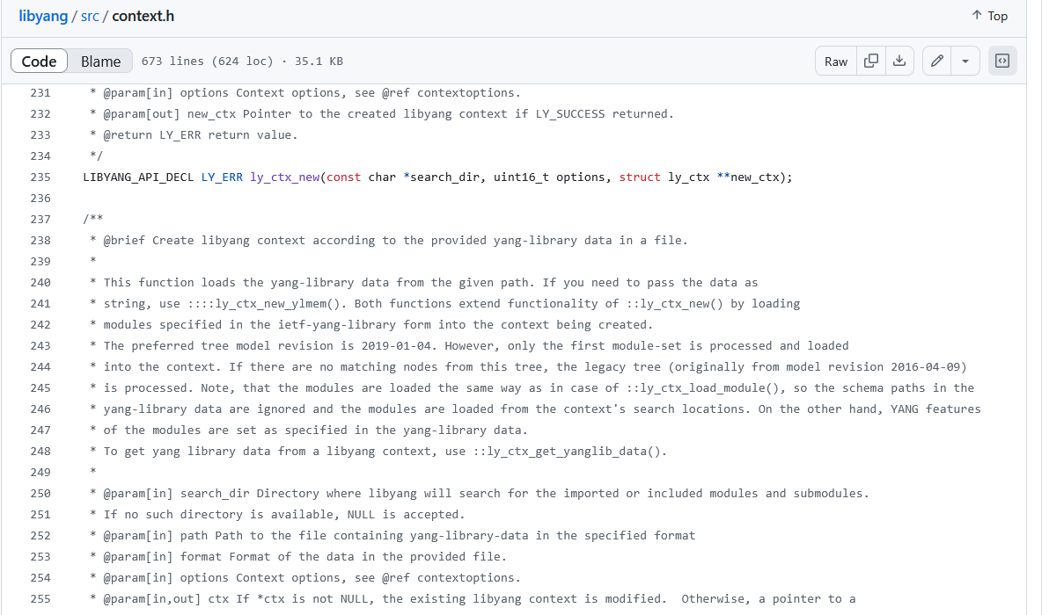
YANG Library findings - Libyang
Section 3 of RFC 8525 (YANG-Library) describes the relationships between Datastore <-> Datastore Schema <-> Module Sets <-> Modules in context of NMDA defined in RFC 8342.
In the hackathon end to end testing, we discovered that libyang doesn't take datastore and datastore schema into context.
NMOP & NETCONF WG
module: ietf-yang-library
+--ro yang-library
+--ro module-set* [name]
| +--ro name string
| +--ro module* [name]
| | +--ro name yang:yang-identifier
| | +--ro revision? revision-identifier
| | +--ro namespace inet:uri
| | +--ro location* inet:uri
| | +--ro submodule* [name]
| | | +--ro name yang:yang-identifier
| | | +--ro revision? revision-identifier
| | | +--ro location* inet:uri
| | +--ro feature* yang:yang-identifier
| | +--ro deviation* -> ../../module/name
| +--ro import-only-module* [name revision]
| +--ro name yang:yang-identifier
| +--ro revision union
| +--ro namespace inet:uri
| +--ro location* inet:uri
| +--ro submodule* [name]
| +--ro name yang:yang-identifier
| +--ro revision? revision-identifier
| +--ro location* inet:uri
+--ro schema* [name]
| +--ro name string
| +--ro module-set* -> ../../module-set/name
+--ro datastore* [name]
| +--ro name ds:datastore-ref
| +--ro schema -> ../../schema/name
+--ro content-id string

Slide 9
YANG Library findings – IOS XR/VRP
YANG-Push subscribes to the operational datastore as defined in RFC 8641.
In the hackathon end to end testing, we discovered that Cisco IOS XR and Huawei VRP for MA5800 misses the module set, datastore schema mapping for operational datastore.
Cisco IOS XR
<yang-library xmlns="urn:ietf:params:xml:ns:yang:ietf-yang-library">
<schema>
<name>All</name>
<module-set>All</module-set>
</schema>
<schema>
<name>UM-preferred-plus</name>
<module-set>UM-preferred-plus</module-set>
</schema>
<schema>
<name>UM-preferred</name>
<module-set>UM-preferred</module-set>
</schema>
<schema>
<name>XR-only</name>
<module-set>XR-only</module-set>
</schema>
<datastore>
<name xmlns:idx="urn:ietf:params:xml:ns:yang:ietf-datastores">idx:running</name>
<schema>All</schema>
</datastore>
<datastore>
<name xmlns:idx="urn:ietf:params:xml:ns:yang:ietf-datastores">idx:candidate</name>
<schema>All</schema>
</datastore>
</yang-library>
6WIND VSR
<yang-library xmlns="urn:ietf:params:xml:ns:yang:ietf-yang-library">
<schema>
<name>complete</name>
<module-set>complete</module-set>
</schema>
<datastore>
<name xmlns:ds="urn:ietf:params:xml:ns:yang:ietf-datastores">ds:running</name>
<schema>complete</schema>
</datastore>
<datastore>
<name xmlns:ds="urn:ietf:params:xml:ns:yang:ietf-datastores">ds:candidate</name>
<schema>complete</schema>
</datastore>
<datastore>
<name xmlns:ds="urn:ietf:params:xml:ns:yang:ietf-datastores">ds:startup</name>
<schema>complete</schema>
</datastore>
<datastore>
<name xmlns:ds="urn:ietf:params:xml:ns:yang:ietf-datastores">ds:operational</name>
<schema>complete</schema>
</datastore>
</yang-library>
x
NMOP & NETCONF WG
✔
Huawei VRP NE
<yang-library xmlns="urn:ietf:params:xml:ns:yang:ietf-yang-library">
<schema>
<name>config-schema</name>
<module-set>config-module</module-set>
</schema>
<schema>
<name>state-schema</name>
<module-set>config-module</module-set>
<module-set>state-module</module-set>
</schema>
<datastore>
<name xmlns:ds="urn:ietf:params:xml:ns:yang:ietf-datastores">ds:startup</name>
<schema>config-schema</schema>
</datastore>
<datastore>
<name xmlns:ds="urn:ietf:params:xml:ns:yang:ietf-datastores">ds:running</name>
<schema>config-schema</schema>
</datastore>
<datastore>
<name xmlns:ds="urn:ietf:params:xml:ns:yang:ietf-datastores">ds:candidate</name>
<schema>config-schema</schema>
</datastore>
<datastore>
<name xmlns:ds="urn:ietf:params:xml:ns:yang:ietf-datastores">ds:operational</name>
<schema>state-schema</schema>
</datastore>
</yang-library>
x
Huawei VRP MA
<yang-library xmlns="urn:ietf:params:xml:ns:yang:ietf-yang-library">
<schema>
<name>complete</name>
<module-set>complete</module-set>
</schema>
<datastore>
<name xmlns:ds="urn:ietf:params:xml:ns:yang:ietf-datastores">ds:running</name>
<schema>complete</schema>
</datastore>
<datastore>
<name xmlns:ds="urn:ietf:params:xml:ns:yang:ietf-datastores">ds:candidate</name>
<schema>complete</schema>
</datastore>
<datastore>
<name xmlns:ds="urn:ietf:params:xml:ns:yang:ietf-datastores">ds:startup</name>
<schema>complete</schema>
</datastore>
</yang-library>
✔

Slide 10
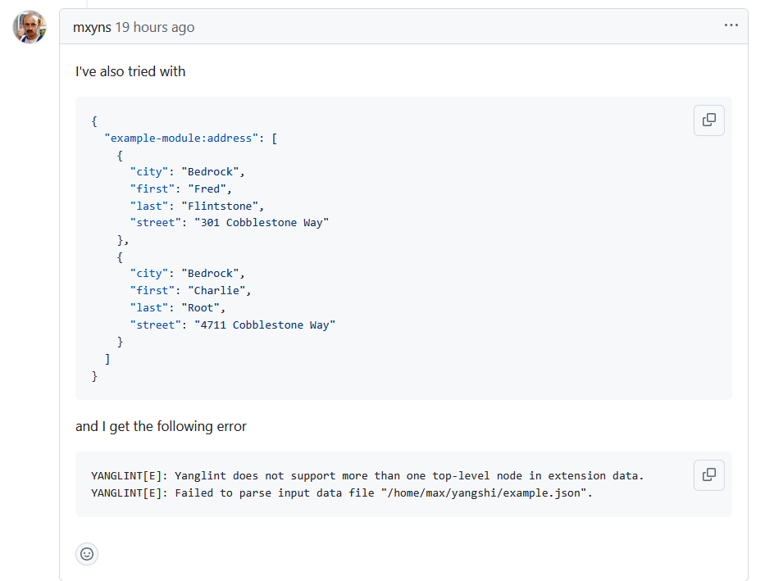
YANG Data Structure Extensions - Yanglint
In IETF 122 hackathon we discovered that YANG Data Structure Extensions are supported in libyang but not in yanglint.
YANG Data Structure Extensions support in yanglint has recently being added and validated in this hackathon. However, there are still issues.
NMOP & NETCONF WG

Slide 11
Register new YANG schema - Payload
The same rest API as other formats such as AVRO, JSON, and ProtoBuf is used to register new YANG schemas.
Hackathon 124 proposal: Lets Support optional YANG features (Section 5.6.2 in RFC 7950) in YANG schema registry.
{
"schemaType": "YANG",
"references": [
{
"name": "other-module-name",
"subject": "registered subject name",
"version": "registered version",
}
],
"metadata": {
"tags": {
"features": ["arbitrary-names", "if-mib"]
}
},
"schema": "... yang schema text"
}
NMOP & NETCONF WG
curl -X POST \
-H "Content-Type: application/vnd.schemaregistry.v1+json"
-d @my-module-request.json \
http://localhost:8081/subjects/my-module/versions
my-module-request.json

Slide 12
Retrieve new YANG schema
{
"schemaType": "YANG",
”subject": "my-module",
"version": 1,
”id": 1,
"references": [
{
"name": "other-module-name",
"subject": "registered subject name",
"version": "registered version",
}
],
"metadata": {
"tags": {
"features": ["arbitrary-names", "if-mib"]
}
},
"schema": "... yang schema text"
}
Retrieve all registered schemas
curl http://localhost:8081/subjects/
Retrieve all registered version of a given subject
curl http://localhost:8081/subjects/my-module
Retrieve a specific version of a schema registry
curl http://localhost:8081/subjects/my-module/versions/1
Retrieve a schema by ID
http://localhost:8081/schemas/ids/1
NMOP & NETCONF WG
Result of getting schema from schema registry

Slide 13
Apache Kafka wire format
Data is encoded in native YANG format (JSON, CBOR).
Schema ID is included in the header.
Content type is encoded in the header using the standard allocated in IANA (RFC 8040 and RFC 9254)
{
”headers": [
"schema-id": 1, // schema id registered
"content-type": "application/yang-data+json"
]
"paylod": ..json encoded YANG,
}
NMOP & NETCONF WG
Apache Kafka message value and headers

Slide 14
YANG-Push Test Automation Tool – Test Cases
python3 main.py --config config/yp_test_config.yml --vendor cisco_iosxr --list-tests
Available tests:
yangpush_delete_subsciptions
yangpush_delete_receivers
netconf_get_discover_yang
netconf_get_ietf_notification_capabilities
netconf_get_ietf_system_version
netconf_get_ietf_yang_library_augmentedby
netconf_get_system_capabilities
netconf_get_yang_library
netconf_get_schema_ietf_notification_transport_capabilities
netconf_get_schema_ietf_udp_notif_transport
netconf_get_schema_ietf_yang_library_augmentedby
netconf_get_schema_ietf_yang_push
netconf_get_schema_ietf_yang_push_revision
netconf_get_schema_ietf_yp_notification
netconf_get_schema_ietf_yp_observation
netconf_get_schema_ietf_yp_transport_capabilities
netconf_get_schema_ietf_system_capabilities_yang
yangpush_add_receiver
yangpush_ietf_interface
yangpush_vendor_interface
netconf_get_schema_ietf_interfaces_yang
yangpush_get_subscriptions
yangpush_post_test_cleanup
Available test sequences:
MVP1
capabilities_sequence
NMOP & NETCONF WG

Slide 15
YANG-Push Test Automation Tool – Test Results
python3 main.py --config config/yp_test_config.yml --vendor cisco_iosxr --tests netconf_get_schema_ietf_yp_observation
...Excempted for brevty...
module: ietf-yp-observation
augment /yp:push-update:
+--ro timestamp? yang:date-and-time
+--ro point-in-time? enumeration
augment /yp:push-change-update:
+--ro timestamp? yang:date-and-time
+--ro point-in-time? enumeration
--- TEST 16: netconf_get_schema_ietf_yp_observation - SUCCESS
...Excempted for brevty...
Results directory tree:
ipf-zbl1327-r-daisy-91_cisco_iosxr_20250720_104339/
stdout.log (3475 bytes)
udp_notif_capture.pcap (24 bytes)
kafka_output.json (0 bytes)
yp_config_backup.xml (14269 bytes)
ietf-yp-observation.yang (4311 bytes)
ietf-yp-observation.tree (260 bytes)
NMOP & NETCONF WG

Slide 16
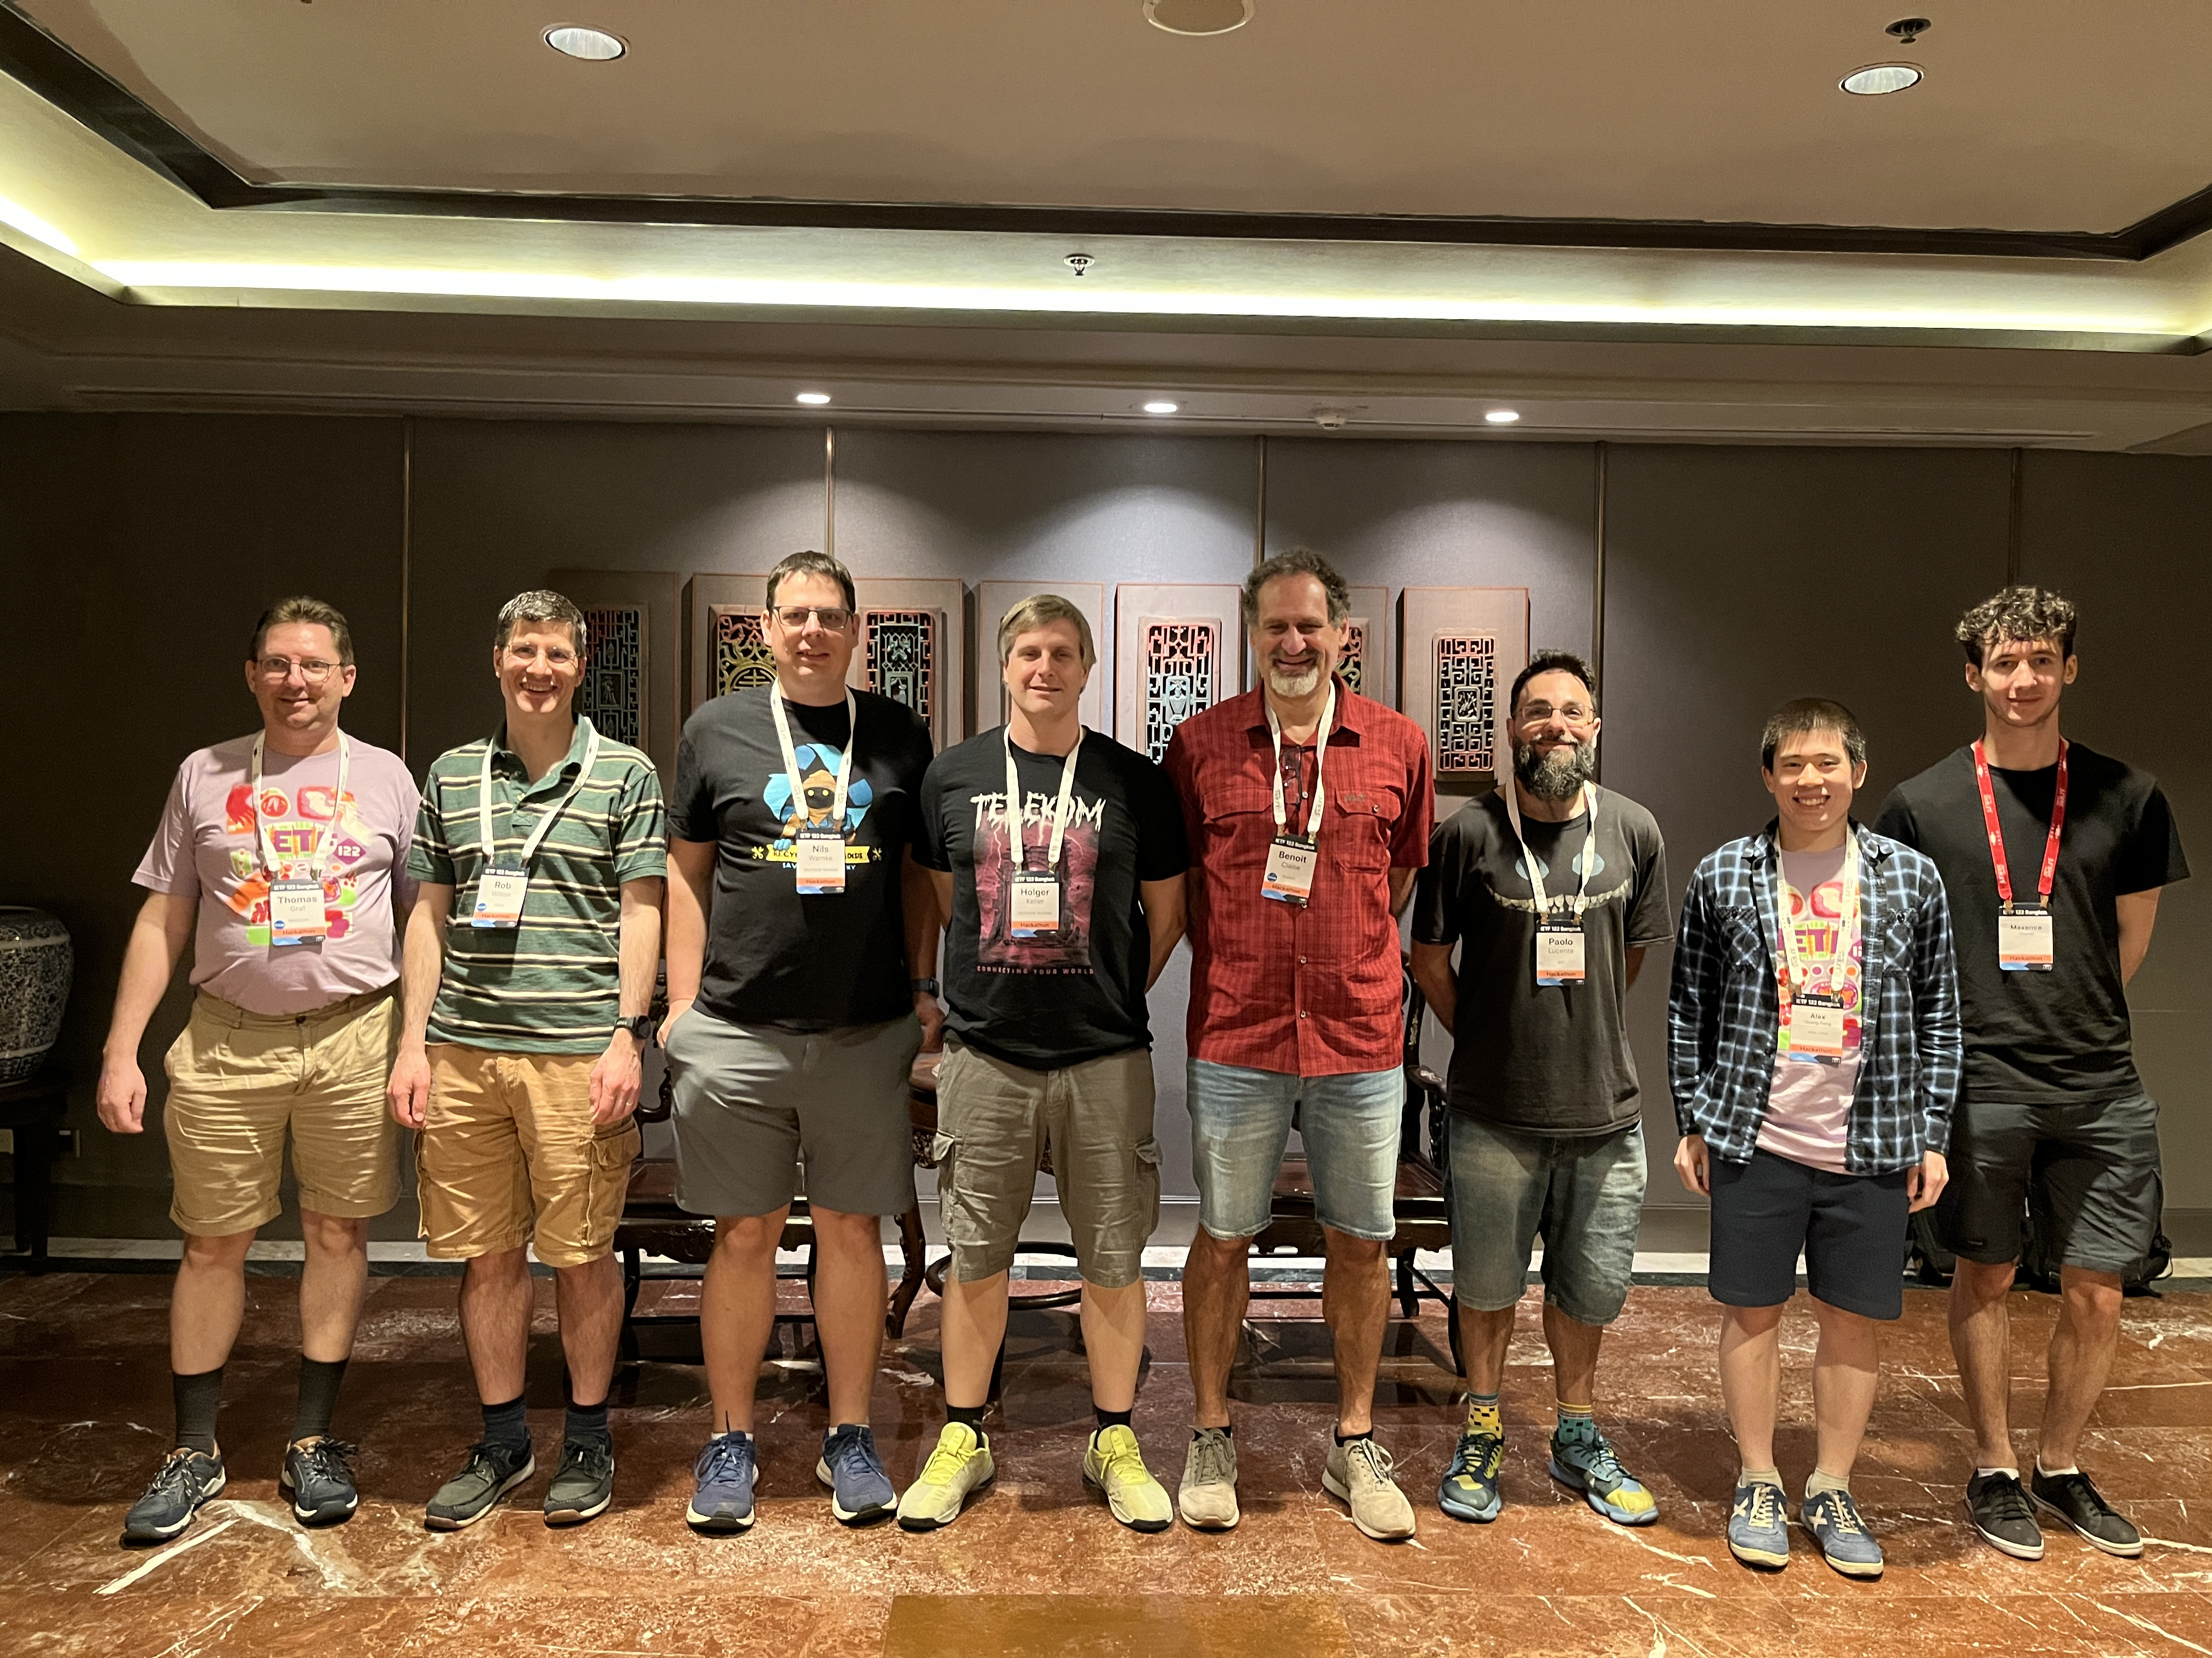
Thanks to…
Rob Wilton – Cisco
Nick Corran – Cisco (remote)
Emma Rankin – Cisco (remote)
Mathew Green – Cisco (remote)
Samuel Gauthier – 6WIND (remote)
Jérémie Leska – 6WIND (remote)
Liu Bin – Huawei (remote)
Benoit Claise – Huawei
Zhuoyao Lin – Huawei (remote)
Jiale Li – Huawei (remote)
Jian Ping– Huawei (remote)
Xiao Chen– Huawei (remote)
Paolo Lucente – Pmacct
Holger Keller – DT
Nils Warnke - DT
Alex Huang-Feng – INSA Lyon
Yannick Buchs – Swisscom (remote)
Ahmed Elhassany - Swisscom
Thomas Graf – Swisscom
NMOP & NETCONF WG
Want to to know more than join us at…
NMOP on Monday 09:30 – 11:30 at Castilla for Message Broker Telemetry Message
NMOP on Wednesday 16:00 – 17:00 at Castilla for more on YANG-Push validation
Side Meeting on Friday 09:30 – 10:30 at El Escorial for the How to Use YANG-Push MVP 1 with Message Broker Integration Demo.

